Slide 1


ERRO –
Emergency Response Route Optimizer
JALGAON
Reducing emergency response time through intelligent route optimization
TS-1 | Domain: Traffic Safety Deployment Area: Jalgaon, Maharashtra
TEAM ERRO
Pratik Patil
Neha Rathod
Sakshi Garud
Bhumi Rajane
Aayush Chinchore
Priyanka Bonde

Slide 2












Every Minute
Matters
Emergencies arise without warning
ACCIDENT
AMBULANCE
TRAFFIC
ROUTE
HOSPITAL
H
Congestion and delays slow ambulances down
Nearest ambulance is not always the fastest
Shortest route does not mean fastest route
Traffic can change while en route
The objective is not simply to find the shortest route;
it is to find the fastest feasible emergency response route.
Coordinating a response needs many decisions at once

Slide 3























ERRO
01
Accident
System Flow
02
Location
03
Ambulance Selection
ERRO is a digital emergency command center built for Jalgaon. It connects every critical decision from the first alert to the hospital handover through intelligent route optimization.
04
Traffic Analysis
05
Route Optimization
06
Live Navigation
07
Hospital Selection

Slide 4























Towards Dhule
Why Jalgaon?
NH-6
Jammer Road
H
MIDC Chowk
Junclu
Simulated Unit B
Maharashtra’s MEMS framework employs GIS/GPS/AVL tech for emergency medical response
NH-53
Towards Aurangabad
JALGAON
Pratap Chowk
Station Road Junction
Maharashtra State Disaster Management Authority maintains Jalgaon District Disaster Management Plan and emergency contact infrastructure
H
Simulated Unit A
H
Muktai Ubayalulat
Simulated Unit C
Major city roads
H
Simulated Unit D
Disclaimer: Simulated ambulance locations are prototypes, not verified real-time units.
Highway connections
high traffic areas
Important intersections
NH-733F
H
Prototype / Simulated Emergency Units
Towards Pune

Slide 5


















How
ERRO Works
From incident to hospital — intelligent routing that gets help there faster.
01
02
03
04
05
06
07
08
09
ACCIDENT
DETECTION
SEVERITY ASSESSMENT
FIND AVAILABLE UNITS
ANALYZE TRAFFIC
DIJKSTRA / GRAPH ENGINE
FASTEST ROUTE
DISPATCH
HOSPITAL

Slide 6






Technology Stack
HTML5, CSS3, and JavaScript power the dashboard, maps, simulations, animations, and alerts
FRONTEND
C language handles graph processing, Dijkstra algorithm, route optimization, and traffic-weight calculations
CORE ENGINE
WebAssembly connects the JavaScript frontend with the C routing engine
INTEGRATION
Jalgaon road network, simulated ambulances and hospitals, traffic conditions, and accident scenarios
DATA SOURCES

Slide 7












The Algorithm
2
TRADITIONAL APPROACH
ERRO APPROACH
A
B
Available ambulances
FASTEST ROUTE
5
3
Nearest ambulance
Shortest route
Traffic analysis
C
Road conditions
ALTERNATIVE PATHS
Estimated travel time
2
8
Dijkstra algorithm
D
E
Fastest emergency route
2
We optimize for response time, not just geographical distance.

Slide 8







Main Features
Powering faster, smarter emergency response in Jalgaon
01
Accident Simulation
02
Smart Ambulance Selection
03
Jalgaon Live Map
Create incidents instantly when every second counts.
See roads, vehicles, incidents and hospitals in real time.
Choose the best available ambulance in seconds.
04
Dynamic Traffic
05
Intelligent Routing
06
Hospital Selection
Traffic changes trigger instant route recalculation.
C-based Dijkstra engine computes the optimal route.
Finds the right hospital based on distance and availability.

Slide 9
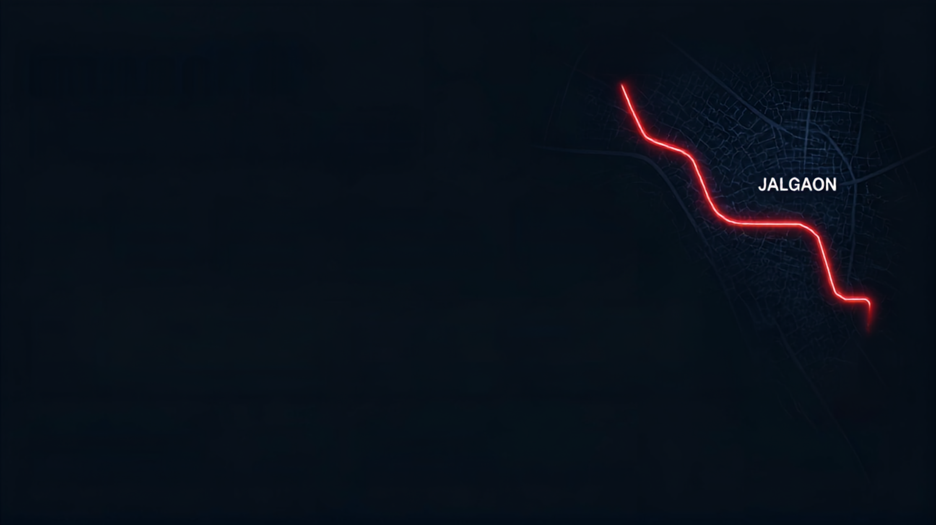



















Impact &
Accident
Future Scope
JALGAON
faster
smarter
traffic-aware
seamless
scalable
response times
resource allocation
routing in real conditions
coordination from accident to hospital
from Jalgaon to any city
Current
Jalgaon Prototype
Real-time GPS
Real-time Traffic
In APIs
IoT / Vehicle Tracking
Accident Detection AI
Hospital APIs
Multi-city Emergency Network
Hospital
Every Second
Make Your
Saved Can Save a Life.
Jalgaon Map the Hero.

